Slide 1
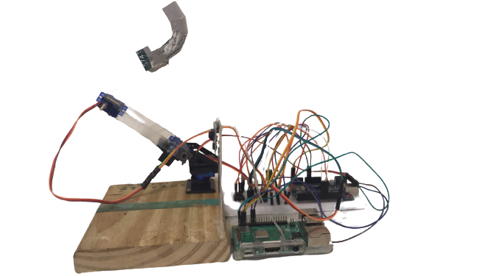
Vision-based robot arm for basketball shooting using monocular camera
組員: 吳承宗 林易賢 徐綺柔 指導教授: 余執彰

Slide 2
OUTLINE
Introduction
Introduction of robot arm
Introduction to Monocular Ranging
Implementation and image processing of monocular distance measurement
summary

Slide 3
Introduction

Slide 4
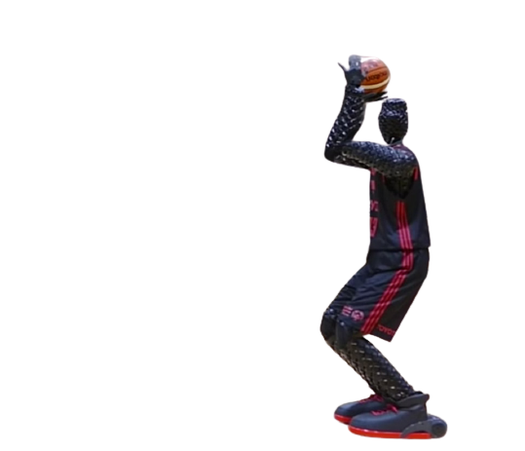
Motivation

Slide 5
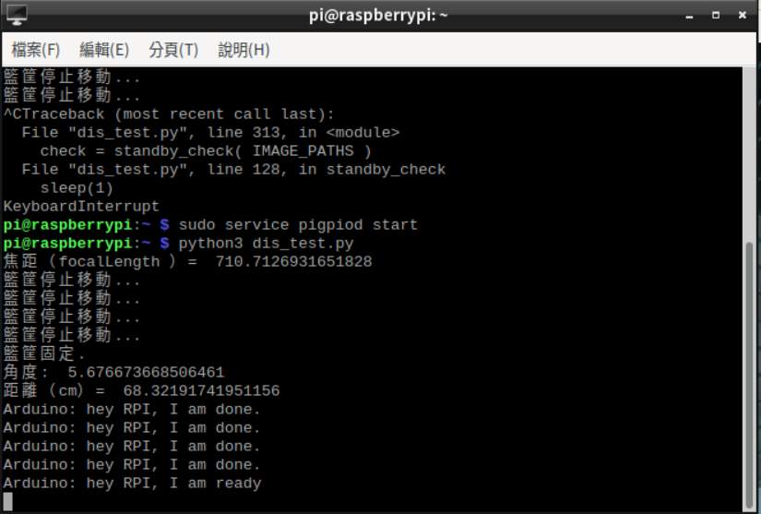
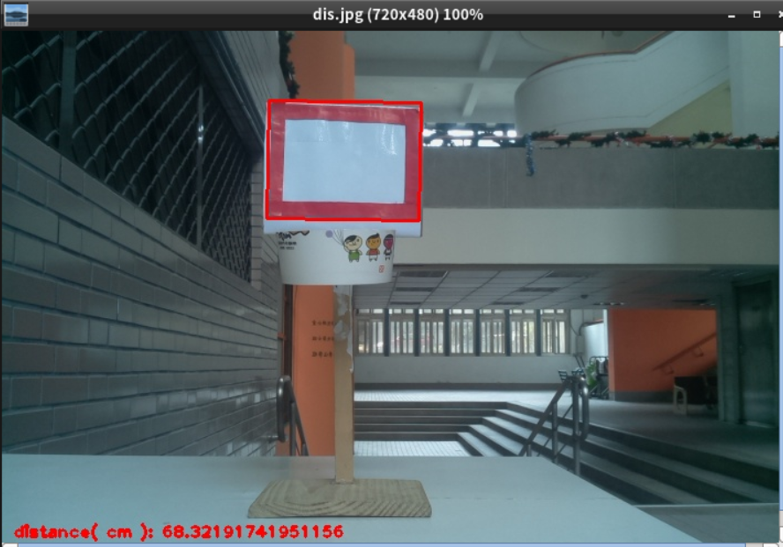
Introduction
(圖一)
(圖二)
Figure 1 shows after the program starts running,
Information displayed.
Figure 2 shows after the program starts running,
Display the screen detected by the camera.

Slide 6
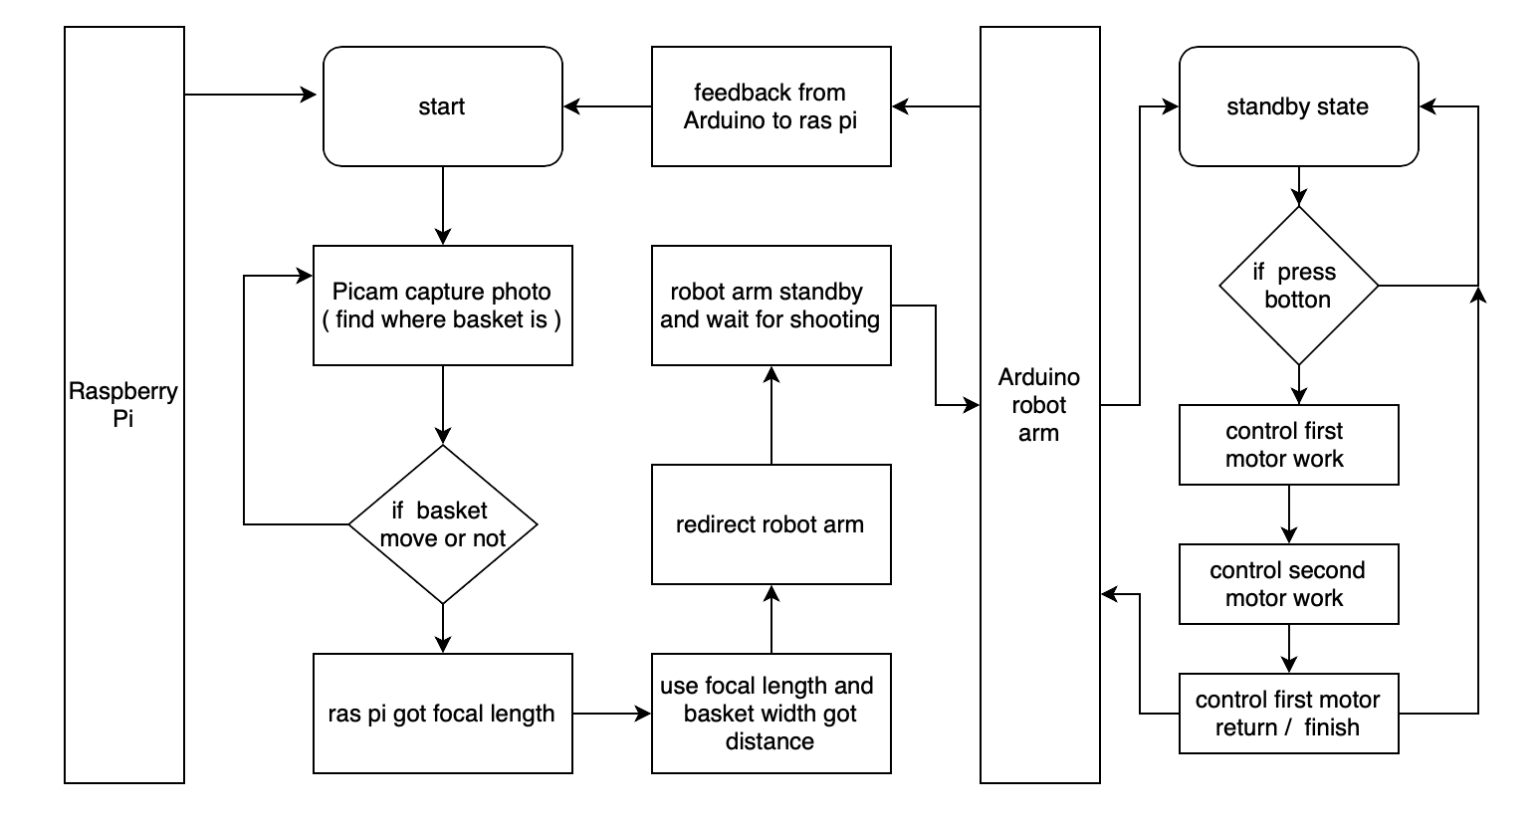
flow chart

Slide 7
Introduction of machine arm

Slide 8
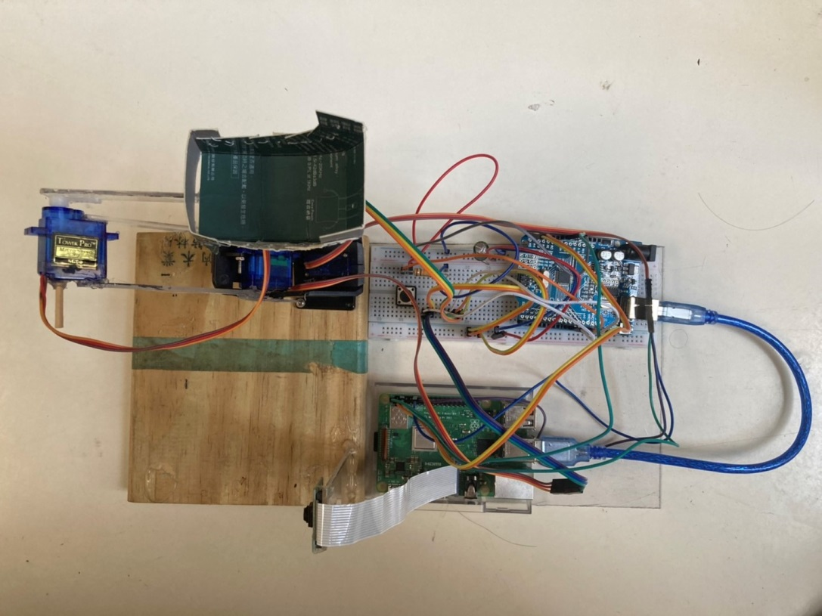
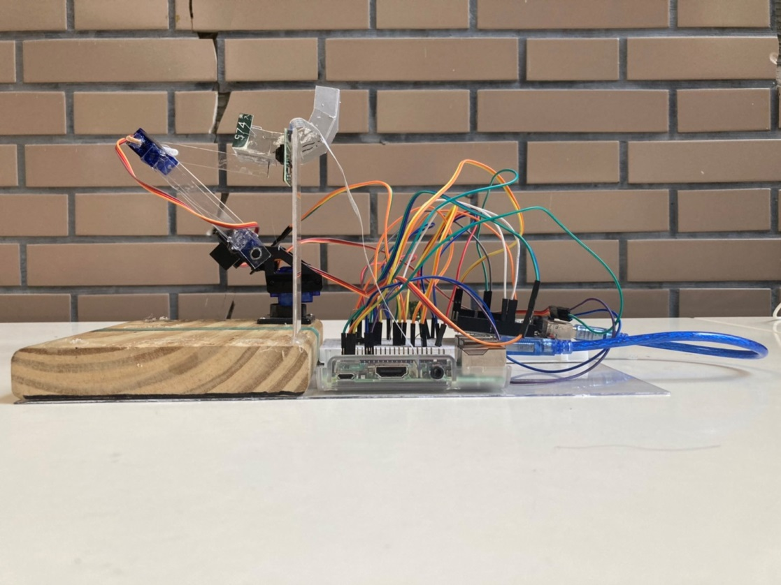
(俯視圖)
The rough wiring configuration can be seen from the top view.
In the side view,
The camera is fixed on the
acrylic plate.
To facilitate the detection
of the basket.
(側拍圖)

Slide 9
Introduction to Monocular Ranging

Slide 10
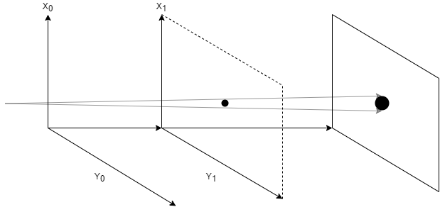
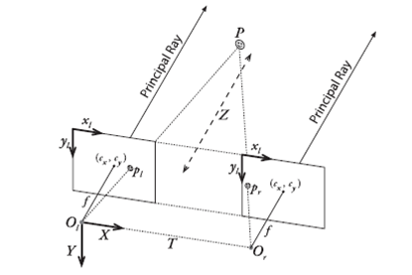
(圖三)
(圖四)
Figure 3 is a schematic diagram of the principle of monocular distance measurement. The distance can be calculated by observing the size of the same object at different distances under one viewing angle.
Figure 4 is a schematic diagram of the principle of binocular ranging. It calculates the distance through two viewing angles, combining the distance between the two viewing angles and the parallax of the target point.
Notes:
接下來我要介紹的是單目測距，在開始之前，我簡單說明一下，單目測距的單目是什麼
意思，單目顧名思義就是用一個鏡頭或者說單一視角來做測距，那有單目自然也有雙目
，圖二就是雙目測距的原理示意圖，比較貼近的例子就是我們人的眼睛，人的眼睛就是
一種天然的測距構造。回到我們的主題單目測距，那怎麼用一張圖或者說一個視角得到
距離呢 ?他其實就是運用一個相似三角型的概念，你的畫面中必須有一個已知寬度或長
度的物體，然後你會需要一張包含該物體的基準圖片，那透過這張基準圖片，和後續要
測距的照片比較計算，就可以測出距離。

Slide 11
Implementation and image processing of monocular distance measurement

Slide 12
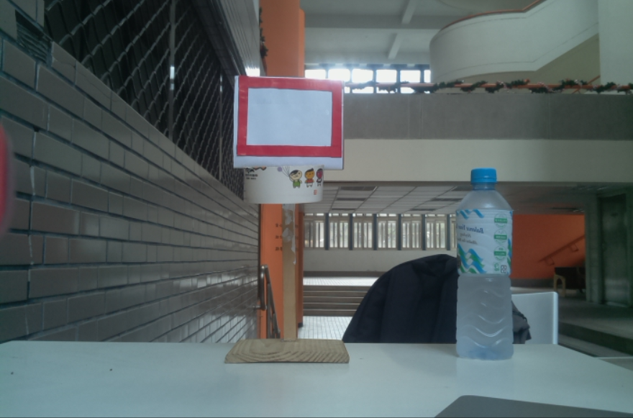
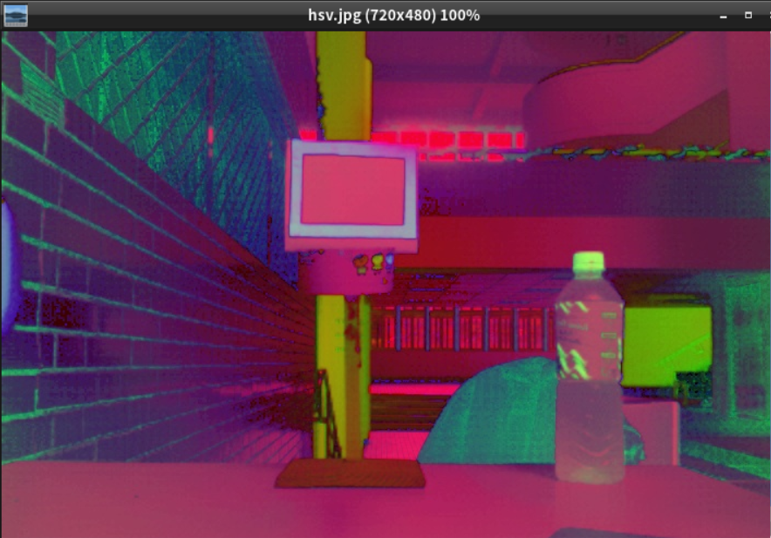
(圖五)原始圖片
(圖六)經HSV轉換之圖片
Preprocess the picture to reduce the impact of light and environment,
At the same time, find out the red block that is suspected of the basket, and wait for the judgment later.
Notes:
這個部分就是單目測距的實作，首先我們會對鏡頭擷取的照片做預處理。
這個預處理是HSV的轉換，然後我們會同時對圖片中的紅色區塊做標記。
做這個HSV轉換的目的是為了降低環境造成的影響，讓各個色塊的辨別更加清楚。
它的概念是將原本由RGB所定義的顏色，轉由HSV表示，即色相(H)，飽和度(S)，明度(V)。
舉個例子，比如說今天我有兩種紅色，亮紅及暗紅，那對RGB來說這兩種顏色就是兩組不同RGB數字
可是對HSV來說，亮紅及暗紅，就只是飽和度和明度的差異，他的色相是一樣的。

Slide 13
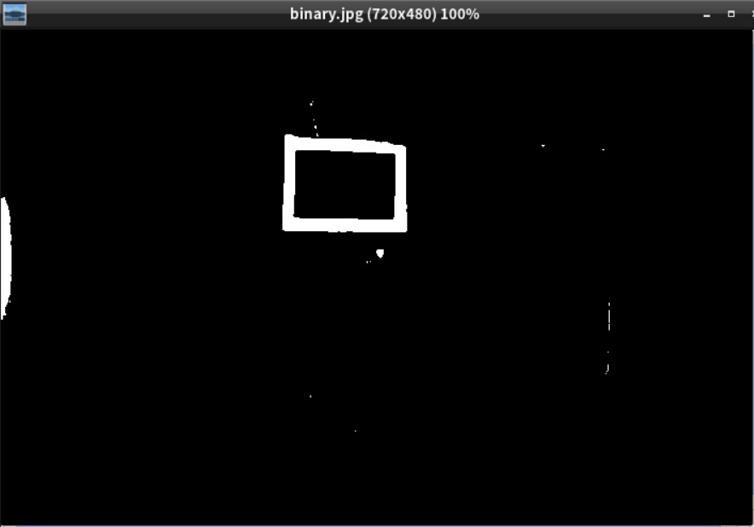
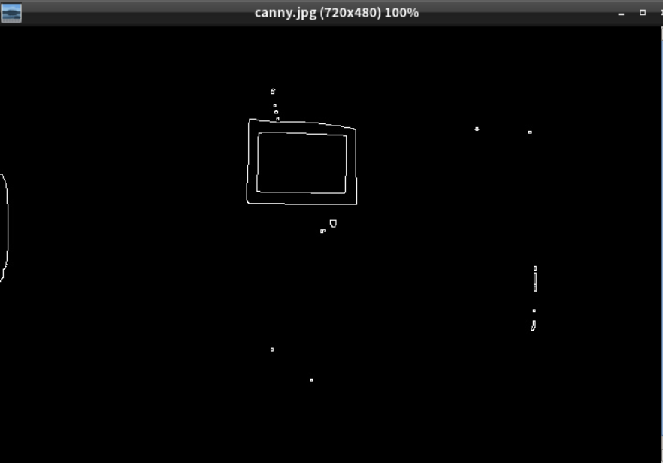
(圖七)HSV圖片Binary化
(圖八)圖五Canny之結果
Through image processing, the contour of the object is obtained. Since the red color block has been calibrated in advance, the remaining contour is the contour of the red object
Notes:
這個步驟的目的在於，取得我們所需要的籃框輪廓。
左邊這張圖就是HSV圖再經過Binary化，白色的部分就是那些紅色色塊。
而右邊是經Canny化的結果，它的原理，簡單來說就是透過將畫面分割成無數小塊，
比較相鄰兩小塊圖片的色差，如果色差過大，那就在中間標記一個白點，
最後整張圖片處理完就是右邊那張圖的樣子，白點會描繪出物體的輪廓。

Slide 14
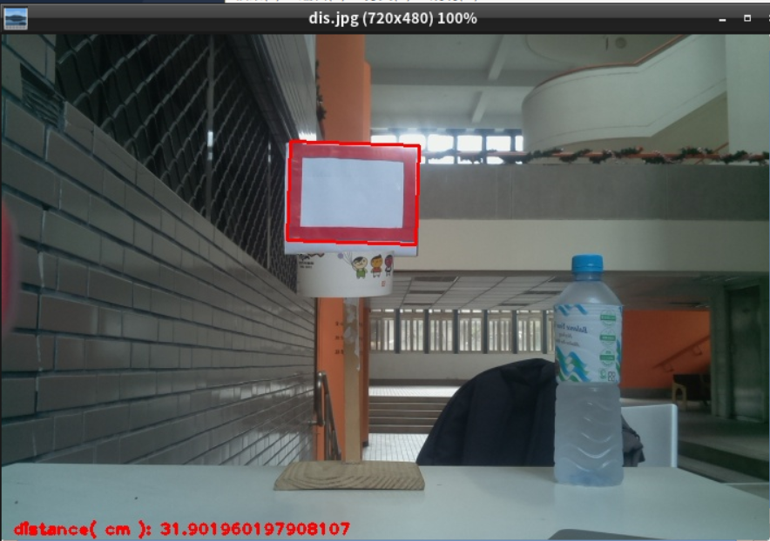
(圖九)測距成果演示
The red box in the picture is the mark of the basket frame defined by the formula, and the distance shown in the lower right corner is the distance measured by the formula.
Notes:
在上一步，我們已經得到所有紅色物體的輪廓，
那接下來我們就會經由程式篩選出一個最大的點集，
然後透過這個點集，重新生成一個最大面積的矩形，就是畫面上的紅框。
然後我們會透過這個矩形的長寬去跟基準照片做計算，運算的結果即為我們程式測定之距離。

Slide 15
summary

Slide 16
The range of distance measurement is limited. Currently, it can only measure a distance within 1 meter. If the distance exceeds 1 meter, the distance measurement will have a large deviation.
If the outer frame of the basket is detected, the ranging result will be accurate; otherwise, the detection of the inner frame will result in a ranging error
The SG90 servo motor has poor quality and limited functions.

Slide 17
未來方向
Can control arm output
Improve the shaking of the motor
Increase the angle of rotation
Improve the power supply system

